Slide 1

Chapter 14
Graphs
© 2011 Pearson Addison-Wesley. All rights reserved
14 A-<number>

Slide 2
Terminology
G = {V, E}
A graph G consists of two sets
  A set V of vertices, or nodes
  A set E of edges
A subgraph
  Consists of a subset of a graph’s vertices and a subset of its edges
Adjacent vertices
  Two vertices that are joined by an edge
© 2011 Pearson Addison-Wesley. All rights reserved
14 A-<number>

Slide 3
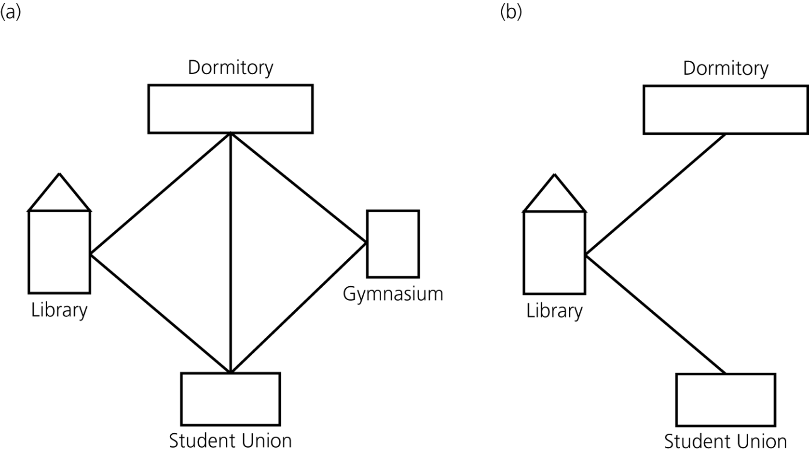
Terminology
Figure 14-2
a) A campus map as a graph; b) a subgraph
© 2011 Pearson Addison-Wesley. All rights reserved
14 A-<number>

Slide 4
Terminology
A path between two vertices
  A sequence of edges that begins at one vertex and ends at another vertex
  May pass through the same vertex more than once
A simple path
  A path that passes through a vertex only once
A cycle
  A path that begins and ends at the same vertex
A simple cycle
  A cycle that does not pass through a vertex more than once
© 2011 Pearson Addison-Wesley. All rights reserved
14 A-<number>

Slide 5
Terminology
A connected graph
  A graph that has a path between each pair of distinct vertices
A disconnected graph
  A graph that has at least one pair of vertices without a path between them
A complete graph
  A graph that has an edge between each pair of distinct vertices
© 2011 Pearson Addison-Wesley. All rights reserved
14 A-<number>

Slide 6
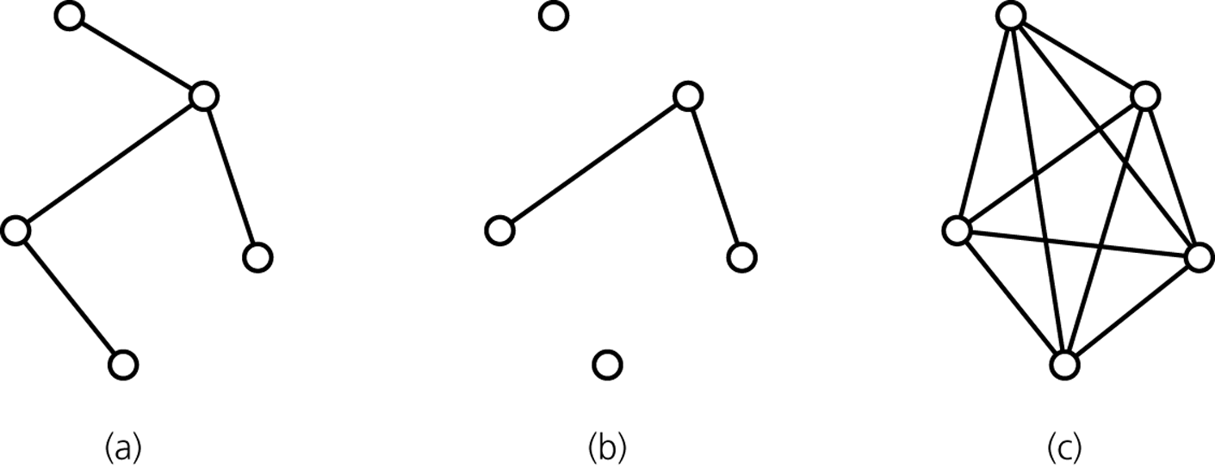
Terminology
Figure 14-3
Graphs that are a) connected; b) disconnected; and c) complete
© 2011 Pearson Addison-Wesley. All rights reserved
14 A-<number>

Slide 7
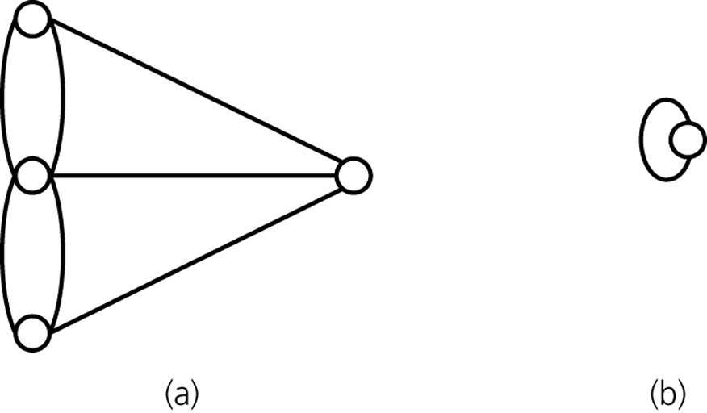
Terminology
Multigraph
  Not a graph
  Allows multiple edges between vertices
Figure 14-4
a) A multigraph is not a graph; b) a self edge is not allowed in a graph
© 2011 Pearson Addison-Wesley. All rights reserved
14 A-<number>

Slide 8
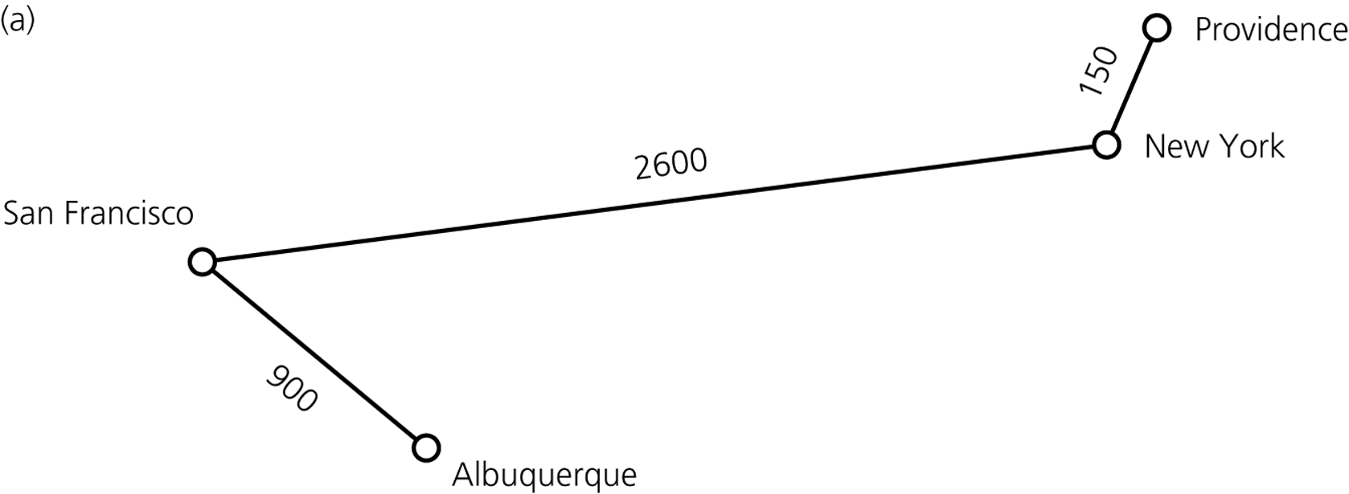
Terminology
Weighted graph
  A graph whose edges have numeric labels
Figure 14-5a
a) A weighted graph
© 2011 Pearson Addison-Wesley. All rights reserved
14 A-<number>

Slide 9
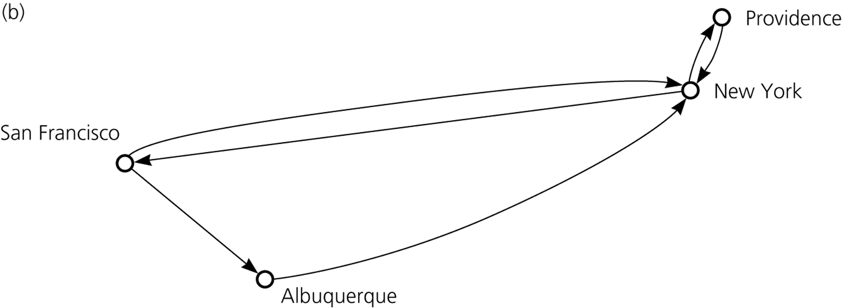
Terminology
Undirected graph
  Edges do not indicate a direction
Directed graph, or diagraph
  Each edge is a directed edge
Figure 14-5b
b) A directed graph
© 2011 Pearson Addison-Wesley. All rights reserved
14 A-<number>

Slide 10
Terminology
Directed graph
  Can have two edges between a pair of vertices, one in each direction
  Directed path
    A sequence of directed edges between two vertices
  Vertex y is adjacent to vertex x if
    There is a directed edge from x to y
© 2011 Pearson Addison-Wesley. All rights reserved
14 A-<number>

Slide 11
Graphs As ADTs
Graphs can be used as abstract data types
Two options for defining graphs
  Vertices contain values
  Vertices do not contain values
Operations of the ADT graph
  Create an empty graph
  Determine whether a graph is empty
  Determine the number of vertices in a graph
  Determine the number of edges in a graph
© 2011 Pearson Addison-Wesley. All rights reserved
14 A-<number>

Slide 12
Graphs As ADTs
Operations of the ADT graph (Continued)
  Determine whether an edge exists between two given vertices; for weighted graphs, return weight value
  Insert a vertex in a graph whose vertices have distinct search keys that differ from the new vertex’s search key
  Insert an edge between two given vertices in a graph
  Delete a particular vertex from a graph and any edges between the vertex and other vertices
  Delete the edge between two given vertices in a graph
  Retrieve from a graph the vertex that contains a given search key
© 2011 Pearson Addison-Wesley. All rights reserved
14 A-<number>

Slide 13
Implementing Graphs
Most common implementations of a graph
  Adjacency matrix
  Adjacency list
Adjacency matrix
  Adjacency matrix for a graph with n vertices numbered 0, 1, …, n – 1
    An n by n array matrix such that matrix[i][j] is
      1 (or true) if there is an edge from vertex i to vertex j
      0 (or false) if there is no edge from vertex i to vertex j
© 2011 Pearson Addison-Wesley. All rights reserved
14 A-<number>

Slide 14
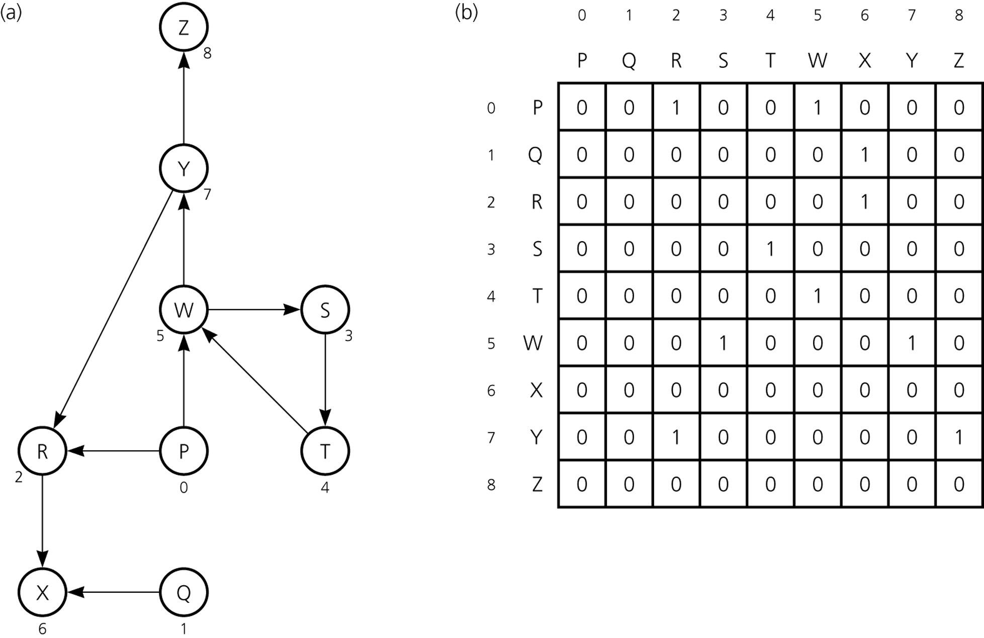
Implementing Graphs
Figure 14-6
a) A directed graph and b) its adjacency matrix
© 2011 Pearson Addison-Wesley. All rights reserved
14 A-<number>

Slide 15
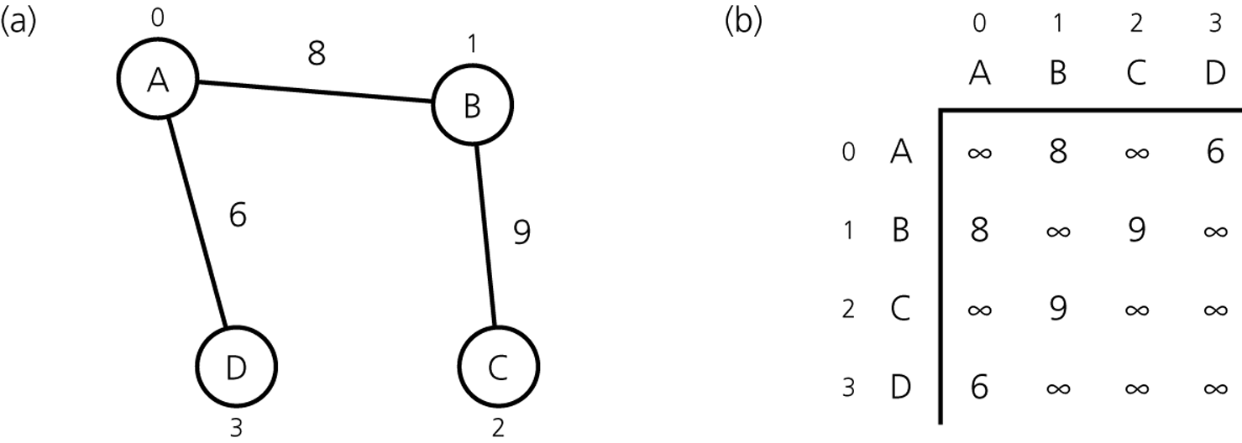
Implementing Graphs
Adjacency matrix for a weighted graph with n vertices numbered 0, 1, …, n – 1
  An n by n array matrix such that matrix[i][j] is
    The weight that labels the edge from vertex i to vertex j if there is an edge from i to j
    ∞ if there is no edge from vertex i to vertex j
Figure 14-7
a) A weighted undirected graph and b) its adjacency matrix
© 2011 Pearson Addison-Wesley. All rights reserved
14 A-<number>

Slide 16
Implementing Graphs
Adjacency list
  An adjacency list for a graph with n vertices numbered 0, 1, …, n – 1
    Consists of n linked lists
    The i^{th} linked list has a node for vertex j if and only if the graph contains an edge from vertex i to vertex j
      This node can contain either
        Vertex j’s value, if any
        An indication of vertex j’s identity
© 2011 Pearson Addison-Wesley. All rights reserved
14 A-<number>

Slide 17
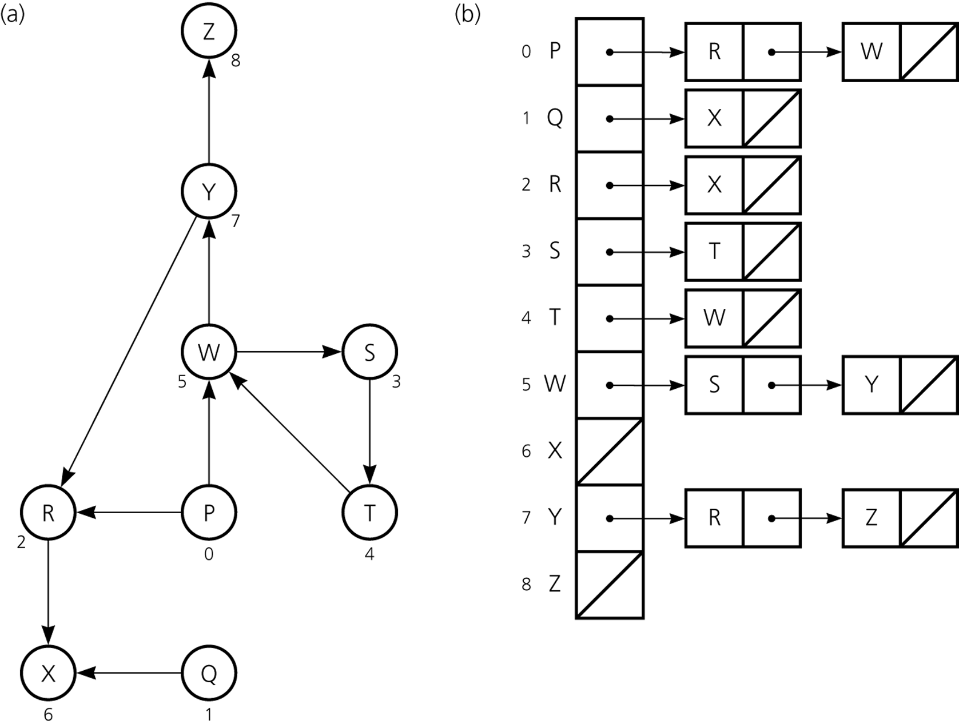
Implementing Graphs
Figure 14-8
a) A directed graph and b) its adjacency list
© 2011 Pearson Addison-Wesley. All rights reserved
14 A-<number>

Slide 18
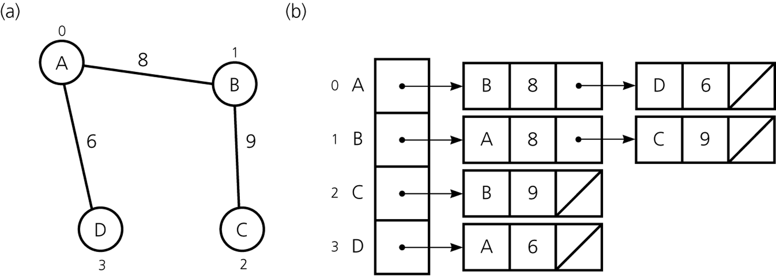
Implementing Graphs
Adjacency list for an undirected graph
  Treats each edge as if it were two directed edges in opposite directions
Figure 14-9
a) A weighted undirected graph and b) its adjacency list
© 2011 Pearson Addison-Wesley. All rights reserved
14 A-<number>

Slide 19
Implementing Graphs
Adjacency matrix compared with adjacency list
  Two common operations on graphs
    Determine whether there is an edge from vertex i to vertex j
    Find all vertices adjacent to a given vertex i
  Adjacency matrix
    Supports operation 1 more efficiently
  Adjacency list
    Supports operation 2 more efficiently
    Often requires less space than an adjacency matrix
© 2011 Pearson Addison-Wesley. All rights reserved
14 A-<number>

Slide 20
Implementing a Graph Class Using the JCF
ADT graph not part of JCF
Can implement a graph using an adjacency list consisting of a vector of maps
Implementation presented uses TreeSet class
© 2011 Pearson Addison-Wesley. All rights reserved
5 B-<number>

Slide 21
Graph Traversals
A graph-traversal algorithm
  Visits all the vertices that it can reach
  Visits all vertices of the graph if and only if the graph is connected
    A connected component
      The subset of vertices visited during a traversal that begins at a given vertex
  Can loop indefinitely if a graph contains a loop
    To prevent this, the algorithm must
      Mark each vertex during a visit, and
      Never visit a vertex more than once
© 2011 Pearson Addison-Wesley. All rights reserved
14 A-<number>

Slide 22
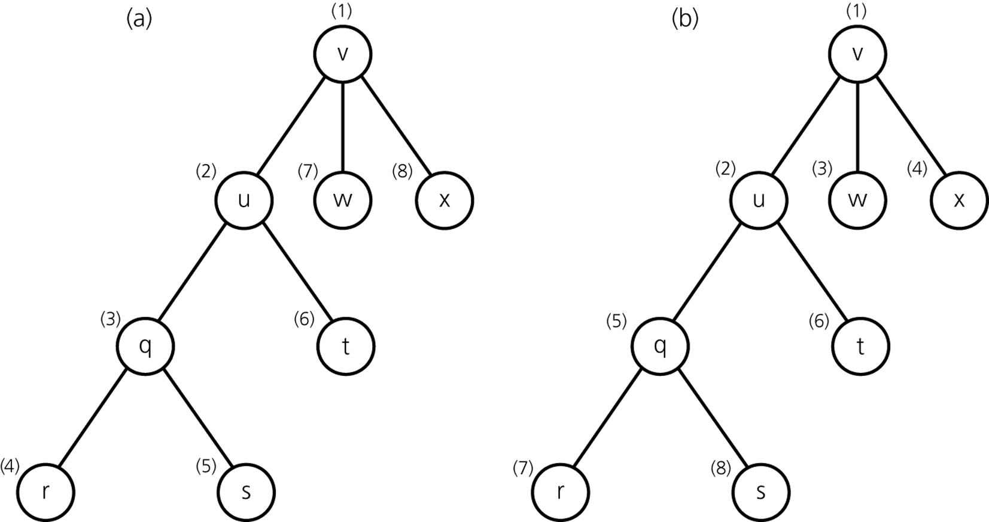
Graph Traversals
Figure 14-10
Visitation order for a) a depth-first search; b) a breadth-first search
© 2011 Pearson Addison-Wesley. All rights reserved
14 A-<number>

Slide 23
Please open file carrano_ppt14_B.ppt
to continue viewing chapter 14.
© 2011 Pearson Addison-Wesley. All rights reserved
14 A-<number>

